Slide 1
SaYS
Everything easy
SOWGENYA R
YOGALAKSHMI R
ASHOK K
SREEPARVATHY V S
IC2021-062

Slide 2

Problems
Difficult to take important points from lengthy documents
What SaYS is trying to solve
Simultaneously listening and taking notes during conference, seminars , trainings and workshops is a tedious job
Quality check for E-books is manual

Slide 3
Solutions
SaYS in action
A Platform which
SUMMARIZES ABSTRACTIVELY
PARAPHASES
QUALITY CHECK FOR EBOOKS
MAKES THE MoM
DETECTS THE SPAM CONTENT

Slide 4







UNIQUE VALUE PROPOSTION
UNFAIR ADVANTAGE
All services in a single web platform
Abstractive Text Summarization
Quality Assurance for E-Books
Minutes Of Meeting
More at Less price
Option to control the range of sentences in paraphrasing

Slide 5








KEY METRICS
CUSTOMER SEGMENT
Students (Age group of 10 and above)
Number of website visitors
Companies - Office employees
Number of premium mode users
Training Centers, Seminar Conductors, Public Speakers, Public Conference
Workshops
Number of companies with subscriptions

Slide 6




Abstractive Text Summarization / Extra Sentence
Quality Check Services for E-Books
SaYS
Minutes of Meeting
service
Not a User Friendly
User Friendly
Extractive Text Summarization /No Extra Sentence

Slide 7



Channels
Path to Customers
Word of Mouth
Direct Approach to companies for the service
Social Media platforms

Slide 8



Prototype Development
Cost Structure
Marketing Expenses
Set Pricing and identify areas where expenses can be reduced
Maintenance Cost

Slide 9


Service Revenue
Recurring
Revenue
Service to public speakers
(depends upon the timings)
Premium – 200 INR /Month
Subscriptions – 3000 INR/Month/10 Employees

Slide 10
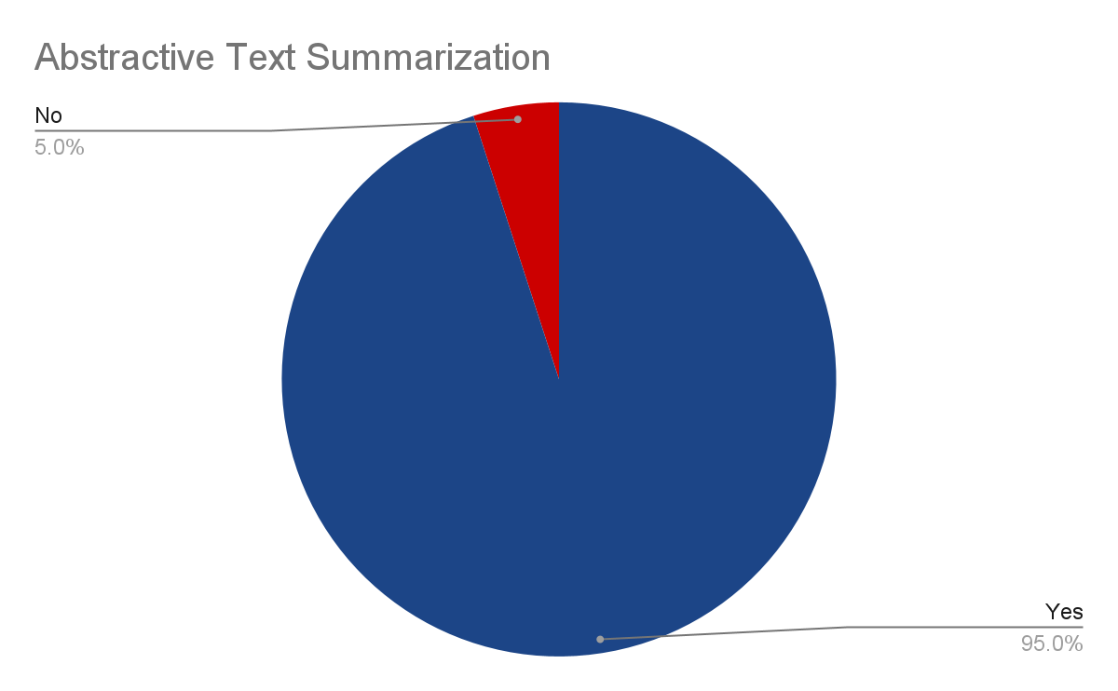
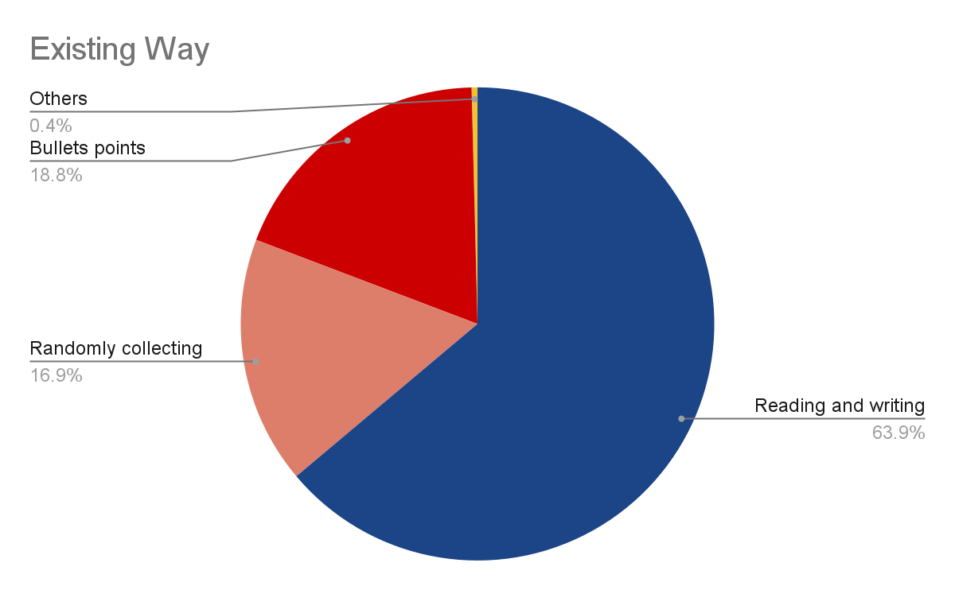
SURVEY

Slide 11
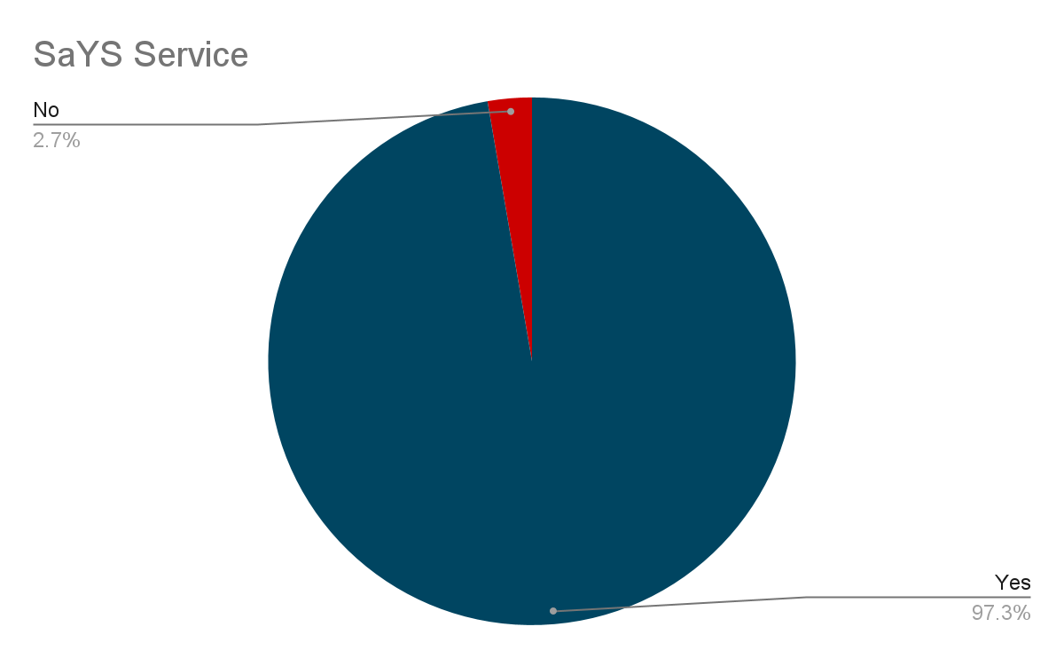

Slide 12

Future Roadmap
SaYS's next steps
2021
___
___
2028
2023
150 companies
20000 active users
250 companies
40000 active users
1500 companies
100000 active users

Slide 13
Thank You!!!

